Slide 1
Business Service Presentation
Welcome, new students!

Slide 2
Business Services Overview
Bookstore
Copy Center
EagleOne
Licensing
Parking Management
Post Office

Slide 3
Bookstore
Textbooks, Spirit Wear, & Convenience Store
Owned and operated by UMW, all Bookstore profits go directly to support campus life.
Online ordering option:
bookstore.umw.edu
Navigate to “Buy/Rent” under “Textbooks”
Start of classes
Books are picked up
End of Semester
Get money at book buyback
This Summer
Buy online this summer
Or pick out books in-store

Slide 4
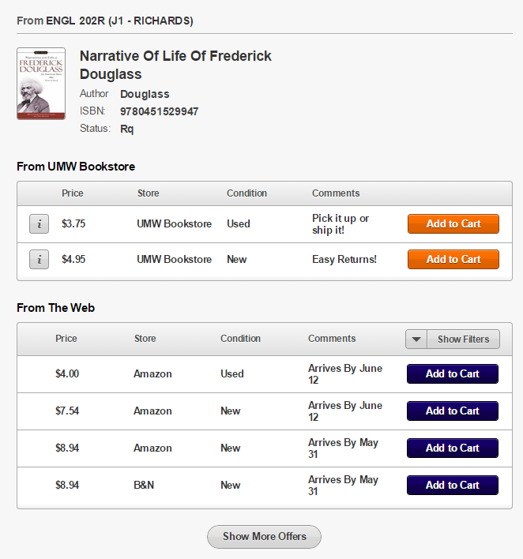
Ways to Save at the Bookstore
More ways to save
Verba Compare
New, Used and Rental Books; Coursepacks
35% of books sold were used!
Book “buybacks”: receive cash at the end of the semester
Textbook Swap on website
$231,884 saved through used book offerings and book buyback!

Slide 5
Copy Center
The Copy Center offers a variety of services to the campus:
Copy
Print
Fax
Scan
Shred
Laminate
Send to print from any location, on or off campus, using webprint.umw.edu
Visit a multifunctional printer (located at Combs, Trinkle, & Simpson) & swipe your EagleOne card.
Select your job and press print
http://adminfinance.umw.edu/copies/
Web Print

Slide 6
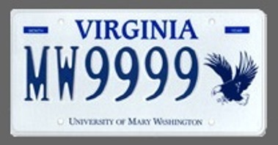
Parking Management
Check out these UMW license plates, brought to you by the VA State DMV!
The UMW Parking Management Office is responsible for ensuring the safe and efficient use of parking resources.
ALL vehicles must be registered
Residential freshmen are not permitted to bring a vehicle on campus (exceptions may apply)
Park in designated areas only
Guests are required to register their vehicle and will receive a dashboard pass
Eligible students may apply for decals starting August 1

Slide 7
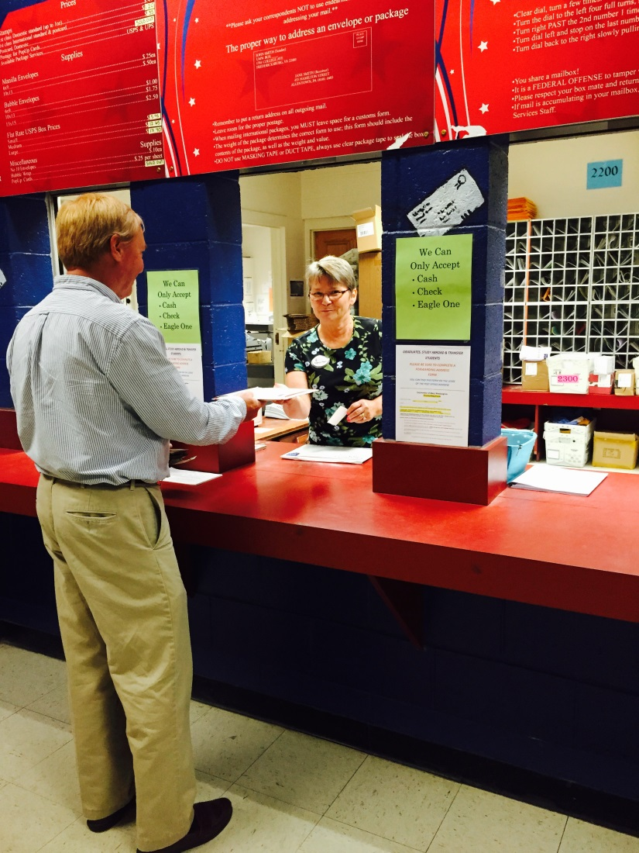
Post Office
Full service mail center located on the first floor of Woodard Campus Center, offering:
Stamps
Mail
Priority
Certified
Registered
International
Overnight
Package shipping (up to 70lbs.)
UPS
Every residential & commuter student is assigned a shared mailbox

Slide 8
EagleOne
Video
EagleOne office in Lee 110
Add money in person, online, or with Blackboard Transact Mobile eAccounts app
Replacements
$20 fee if lost, stolen, or damaged through improper care
Don’t punch holes
Free if damaged through natural wear and tear

Slide 9
EagleOne Money vs. Flex
EagleOne Money
Funds that can be added to your account
Use your card like a debit card
Use on-campus : Bookstore, vending machines, laundry, etc.
Use with off-campus merchant partners
Balance remains entire enrollment
Flex
Part of your meal plan
Accessed with your EagleOne card, but funds are not added through the card office
Can only be used at campus dining facilities
Unused will rollover from fall to spring semester

Slide 10
Come and see us!
Business Services website:
http://adminfinance.umw.edu/business-services/
Twitter:
@UMWBusinessServ

