Slide 1
Business Service Presentation
Welcome, new students!

Slide 2
Business Services Overview
Bookstore
Copy Center
EagleOne
Eagle Vending
Laundry
Licensing
Parking Management
Post Office

Slide 3
UMW Bookstore IS YOUR ONE-STOP SUCCESS SHOP
To get all your course materials quickly and easily
To find all the essentials needed to succeed
To get all you need to show your school spirit
To join student events tailored to empower you
To give back to your school and community

Slide 4
GETTING YOUR COURSE MATERIALS IS EASY
RENT OR BUY course materials from UMW Bookstore and get...
THE RIGHT COURSE MATERIALS: We worked directly with your professors to ensure the right course materials are available for all your classes.
LARGEST SELECTION: Your course required course materials are available through UMW Bookstore
SAVINGS: Save up to 80% when renting course materials from your campus store versus purchasing from the store
PRICE MATCH: We price match Amazon.com for new titles fulfilled and shipped by Amazon. 3rd party market place vendors are not included.
CONVENIENCE: Your Campus Store is right on campus. And Free and Fast in-store pickup is an available option with every online order.
HASSLE-FREE RETURNS: Dropped a class? Get a full refund if you return your book by September 5, 2023 along with your receipt.
GET CASH BACK: Your books may be eligible to sell back to us for cash.

Slide 5
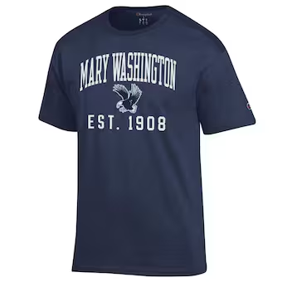
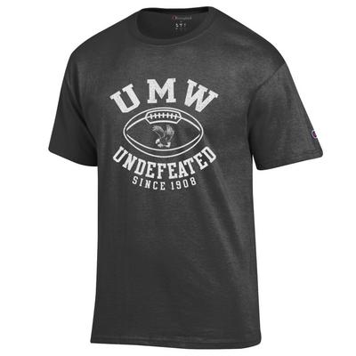
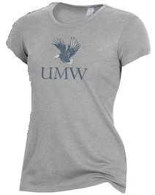
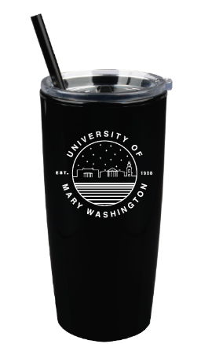
ALL THE ESSENTIALS YOU NEED TO SUCCEED
AND ALL THINGS TO SHOW YOUR SPIRIT
TECHNOLOGY & ELECTRONICS • Jump Drives, Calculators
• Ear Buds, Headphones,
• Phone Chargers & Accessories
SCHOOL & ART SUPPLIES • Binders, Notebooks, Blue Books, Folders
• Pens, Pencils, Highlighters
• Art Kits, Paint
UMW APPAREL & GIFTS • UScape, Champion, League, Tervis, Nalgene
VISIT US IN STORE FOR: • Grab & go snacks & drinks
• A small selection of general reading books
GREAT VALUE with weekly promotions
NEW PRODUCT throughout the year

Slide 6
Copy Center
The Copy Center offers a variety of services to the campus:
Copy
Print
Fax
Scan
Shred
Send to print from any location, on or off campus, using the website
Visit one of 5 multifunctional printers (Combs, Farmer, & Simpson) & swipe your EagleOne card.
Select your job and press print
Web Print

Slide 7
EagleOne Campus Card
Your official campus ID
Getting your card
Visit the EagleOne Card Center in Lee Hall room 110 Monday – Friday 8:00 a.m. – 5:00 p.m.
Bring some form of government issued photo ID
Replacements
$20 fee if lost, stolen, or damaged through improper care
Don’t punch holes
Free if damaged through natural wear and tear

Slide 8
EagleOne Uses
Campus ID
Physical access
Residence Hall
Fitness Center
Labs & classrooms
Debit card
Vending machines
Dining facilities
Copy Center
Debit card (continued)
Post Office
Bookstore
Sheetz & Patriot Subs
Library and computer lab printers
Campus student events
Klein Theater tickets
Health Center
Ride FRED Bus for free

Slide 9
EagleOne vs. Flex
EagleOne Account
Optional debit account
Add money whenever: online or mobile through Transact eAccounts app
Can be used at locations on campus, plus Sheetz and Patriot Subs
Sales tax added to purchases
Flex
Associated with meal plan
Tax free
Only for use at campus dining facilities
Use by swiping EagleOne card

Slide 10
EagleVending
Vending
There are several snack and drink vending machines across campus
Payment methods include EagleOne, credit card, and cash
Locations available here
Report vending issues here
Laundry
All residence halls have laundry machines
Payment is only through the Speed Queen App or quarters
Report laundry issues here

Slide 11
Contact EagleOne
eagleone@umw.edu
(540) 654-1005
Website

Slide 12
Licensing
UMW protects its trademarks and logos
Students and family members—including crafters—should not reproduce UMW trademarks for personal or retail use without a license
Website

Slide 13
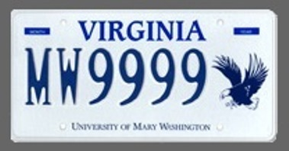
Parking Management
Check out these UMW license plates, brought to you by the VA State DMV!
The UMW Parking Management Office is responsible for ensuring the safe and efficient use of parking resources.
ALL vehicles must be registered
Residential freshmen are not permitted to bring a vehicle on campus (exceptions may apply)
Park in designated areas only
Guests are required to register their vehicle and will receive a dashboard pass
Eligible students may apply for decals starting August 1
Contact us
parking@umw.edu
(540) 654-1129
Parking Website

Slide 14
Post Office
Full service mail center located on the first floor of Woodard Campus Center, offering:
Stamps
Mail
Priority
Certified
Registered
International
Overnight
Package shipping (up to 70lbs.)
UPS
Every residential & commuter student is assigned a shared mailbox
Website

Slide 15
Come and see us!
Business Services website
Social Media
Facebook: UMW Business Services
Instagram: UMW_Business_Services
Twitter: @UMWBusinessServ

