Slide 1
Procurement Services
End User Forum
UMW Procurement Services

Slide 2
Meet the team:
Erma Baker
Melva Kishpaugh
Patricia Canciglia
Dale Elethorp
Monique SanPietro
Michelle Pickham
James DeLoatch
Brittany Miller

Slide 3
Talking Points
Department Overview and updates
Strategic Sourcing
Cobblestone and Contracts
Surplus
IT Purchases
Small Purchase Procedures
SWAM outreach
SPCC and Works
Case Studies and end user scenarios

Slide 4
eVA Vendor Bypass
Architectural Products of VA | Beautiful Floors and Moore
Your Floors Inc | Abel Industries
General Sales of VA | Beltway Supply Inc
Rutherford Janitorial Supply | Temporary Solutions
Premiere Staffing Source Inc | Excel Management Services Inc
1st Choice LLC | Convergint Technologies LLC
Reynolds Lighting Supply Co | B3 Enterprises LLC
Southern Electric Corp | Accurate Printing
Allegra Design Print Mail/ Ferguson Printing | HBP Balmar
B&B Printing | Stafford Printing (Boaz Publishing)
Briggs of VA, Inc dba Print Source | Carter Printing
Notes:
During the last forum, we spoke about the eVA Vendor bypass with TSRC. Ms. Wilma Willard inquired about additional companies being added to this process since they are only used by a handful of buyers. After that, UMW procurement services began working closely with DGS in order to add more vendors to the bypass list. As a result, listed are the following companies that have been added for quick use and ease of service. If the contract number is not in the space exactly, then the transaction will come through the QMGT process.

Slide 5
Strategic Sourcing
Strategic What ?
An approach to supply chain management that formalizes the way that information is gathered and used so than an organization can leverage consolidated purchasing power to find best value in the market place.
Least advantageous – identify need, purchase locally, pay market price.
Better- Identify anticipated spend over a defined period, establish contract, include desk-top-delivery, or other perks
Best- Identify anticipated spend, high frequency needs, establish relationship w/Supplier, guarantee discounts, best pricing on high frequency items, rebates with increasing spend, punch-out catalog. Long term solution.

Slide 6
Strategic Sourcing
Strategic Sourcing
Virginia Higher Education Procurement Cooperative “VHEPC” -11Virginia colleges and universities and VCCS.
VHEPC’s mission is to identify strategic sourcing opportunities, leverage vendors, and recommend courses of action that advance our members’ strategic sourcing initiatives.
Collective “addressable” spend $700M
Current Contract examples: Office Supplies, Lab Supplies, Microsoft SurfacePro, Maintenance Repair & Operating

Slide 7
Client Relations Management “CRM”
Alignment of Departments : Buyers
Initial targets are high spend/high risk departments, such as: Facilities, IT, Admissions, Athletics, SAE, Res Life, Libraries, Police/Safety
Goal: Establish close relationship with departments to understand needs, analyze expenditures, seek opportunities, establish contracts to support needs, assist with forecast of future needs/plans where possible.

Slide 8
Savings and Cost Avoidance
SAVINGS/COST AVOIDANCE
Date | Buyer | Dept | PO, BPO, or Contract # | Vendor | Annual
 |  |  |  |  | Cost Savings | Cost Avoidance | Value Add
7/24/2015 | MSP | Facilities | 16-QQ209052 | Inge Equipment Co., Inc. | $ 3,000.00
8/24/2015 | MM | IT | UCPUMW 15-363 | CoxCom | $ 58,860.00 |  | $ 91,300.00
9/22/2015 | PC | Admissions | UCPUMW 16-410 | Cappex | $ 4,000.00
9/18/2015 | PC | Capital Outlay | UCPUMW 16-470 | Furniture Vendors (Multiple) | $ 37,918.31
Pending | PC | Res. Life | Invoice Correction | Foliot Furniture, Inc. | $ 473.63
 | PC |  |  | VisualZen | $ 1,200.00
11/6/2015 | JD | Biology | EP2313284 | Water-Jacketed CO2 incubator | $ 1,940.10
11/6/2015 | JD | Biology | EP2313284 | Excella 24 Benchtop Shaker | $ 1,709.10
11/6/2015 | JD | Biology | EP2313284 | Wellwash versa mircoplate | $ 918.00
11/18/2015 | JD | Chemistry | EP2312763 | Gas chromatograph system | $ 6,720.35
11/20/2015 | JD | Disability services | EP2314216 | Snap Scanner | $ 195.00
12/2/2015 | JD | Biology | QQ211213 | Arabidopsis Growth Chamber | $ 40.00
12/3/2015 | JD | Disability services | EP2318342 | Desktop Electronic Magnifier | $ 500.00
12/10/2015 | MM | Library | EP2321652 | Scannx | $ 1,769.00
12/11/2015 | MM | Library | UCPUMW 15-437 | ProQuest LLC | $ 12,821.00
12/31/2015 | MSP | Campus Wide | UCPUMW 15-327 | Hyatt Place |  | $ 8,010.00
1/4/2016 | MM | Physics | EP2327579 | Dell | $ 52.54
2/2/2016 | JD | Environmental Science | EP2340110/EP2340384 | POL Microscope and Nikon camera | $ 3,153.19
2/2/2016 | MSP | Facilities | QQ211840 | Lochinvar Storage Tank | $ 1,800.00
6/22/2016 | MSP | Facilities | UCPUMW 13-7 | GCA | $ 5,977.00
6/19/2016 | MK | DTLT | UCPUMW 16-545 | Reclaim Hosting LLC | $ 13,850.00 |  | $ 1,500.00
 |  |  |  | Sub Totals: | $ 156,897.22 | $ 8,010.00 | $ 92,800.00
 |  |  |  | Grand Total: | $ 257,707.22

Slide 9
Cobblestone and University Contracts

Slide 10
Cobblestone and University Contracts
16-381
umw.cobblestonesystems.com/public

Slide 12
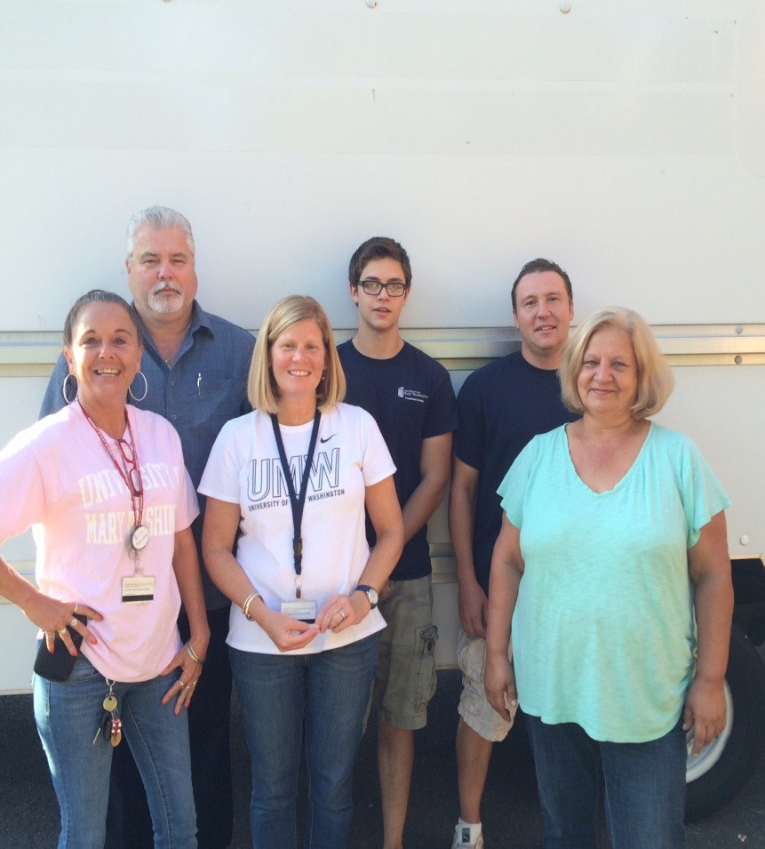
Surplus and Central Stores

Slide 13
IT Purchases
How do I choose which request form to use?
Buy Your Own* (Ex. Non-Apple branded cables/keyboards & mice, presentation remotes, laptop bags, etc.) *Procurement regulations still apply (SBQ, eVA entry, etc.)
Standard Technology Request Form (Ex. Non-customized Dell laptop, MacBooks, monitors, printers, etc.)
Non-Standard Technology Request Form* (Ex. Customized computers, software, non-standard printers) *Use this form for anything not found on the BYO or Standard pages

Slide 14
IT Purchases (continued)
What happens to my order when I submit a request form?
Standard Request: All standard requests get sent directly to me for ordering.
I order all items from Standard form for the end user
Non-Standard Request:
Request is sent to IT where it goes through a review and approval process which could take 1-3 days to complete.
Once the request is approved it’s sent to me for order processing.
If I can order, I will order.
If I can’t order, I will send to the end user/department buyer for ordering with needed documentation and instructions.

Slide 15
Small Purchase Procedures
What is a Small Purchase?
Valued at $50k or less
What are major differences from the former set of procedures?
Revised for reader clarity
Addition of UMW required and preferred contracts with URLs
Forms links
Software & SaaS purchases $50k or less streamlined
Exception Tables organized into categories
Some Exceptions combined, some separated, for ease of use.
What’s the same? $5000
Notes:
A small purchase is valued up to and including $50k
DIFFERENT:
Addition of reference to UMW required and preferred contracts (URLs).
More forms are available on the web, including VCE release request and Emergency purchase approval.
Organization of exemptions by Small business quote requirement and/or eVA entry requirement sections. split into three sections: Each section is alphabetized. Keyword alphabetization is enhanced.
Honoraria processing is separated from Entertainment/Performers as the payment process differs.
Software and SaaS purchases $50k and under still require IT approval - still requires nonstandard IT review, but there is now a simpler procurement process - do not require a competitive solicitation or small business quote.
SAME:
At least one quote is still required for most purchases or purchase from a small business or from an established contract
Competition is still required for most purchases over $5000
Small business usage goal for the University is still 42%
We would love to receive feedback on the revised document, positive or negative!

Slide 16
Department Research – A Caution
DANGER ZONE
UMW Departments
Procurement Organization
Research
Procurement
Investigate
Identify
Recommend
Solicit
Select
Award (Obligate)
Research Must Not Restrict or Take the Place of the Competitive Source Selection Process!
Notes:
Friendly Reminder: An observation that seems fairly consistent from whence I’ve come and here at UMW is an understanding and when Procurement should be engaged in the process.
Under $5K with Purchase Card Authority – Your obligation is (1) Try to find a SWAM Vendor First (UMW Goal is 42% to SWAM); and (2) Make sure that you pay only what is fair and reasonable for the product/service.
In most Instances, Over $5K, you should engage Procurement Services asap to discuss the procurement.
You should never split requirements to stay within the threshold restrictions.
Remember that Quick Quotes are limited to $50K.
Let the Buyer/Specialist know of your plans (short-term and long term) so that special provision such as the one identified can be included when necessary.
There is fine line between the market research that you have to perform to assure that UMW gets the best product/services to meet requirements.
It’s ok to call vendors and get information, even get samples, but you cannot make promises that they will get the award if competition is a requirement.
You must let the competitive process select the appropriate vendor based on advertised specifications and evaluation criteria.
Sole Source is an option when there is only one vendor who can provide the product/services because of ownership of proprietary data and when that product/service is the only one that can meet UMW’s requirements. There is a separate process to be followed in that case.
Once you’ve completed your market research, it is imperative that you provide your uniquely developed specifications to the Buyer/Specialist so that you start the Contracting Process.

Slide 17
SWaM Outreach and Events
The implementation of SWAM is sometimes seen as an obstacle when it should be viewed as an opportunity and important initiative.
UMW has a goal of 42% SWaM vendors.
Parameters to be considered for SWaM certification:
250 or fewer employees; or
Under $10 Million in annual sales.
Some recent successes: Sharon M. Allen, CPR Instructor; Trolley Tours of Fredericksburg;
Notes:
Have you ever felt this exasperated trying to get a small purchase made? First you have to find what you’re looking for, find out if the vendor is Small or not, look for a SWAM quote, put it in eVa with all the appropriate codes, get through QGMT.
The implementation of SWAM in the process is sometimes seen as an obstacle when it should be viewed as an opportunity and important initiative. UMW has a goal of 42% and we haven’t met that goal in the two years that I’ve been here. The parameters for SWAM consideration are rather broad, 250 or fewer employees or under $10 Million in annual sales. If you are working with a vendor on a regular basis and you believe they might meet the criteria, shoot me an email with their contact information and I will reach out to them to see if we can get them SWAM certified. It also helps when you place an order with them if you encourage them to get SWAM certified to make the process easier.
Some recent successes: Sharon M. Allen, CPR Instructor; Trolley Tours of Fredericskburg;

Slide 18
SPCC and Works
REMINDERS:
Sign-off and Approval for the appropriate cycle must be completed by the 22nd (or date on billing cycle deadline)
Do not make payment for past due invoices until approval received from DOA
Do not split purchases or payments
TIPS:
Cardholders are able to upload supporting documents to each transaction prior to sign-off
Check to see if your Approver has signed off

Slide 19
Procurement
Scenarios and Q and A
procure@umw.edu
http://adminfinance.umw.edu/procurement/

Slide 20
Scenarios (What Would You Do?)
What happens when I need to pay for a domain subscription?
Complete a non-standard request form, enter into eVA
How long of a subscription can I pay for in advance? /Can I purchase a 24-month subscription?
12-months / No, state law dictates that payments may only live within a 12-month period
Despite attempted negotiations with the vendor, your SPCC non-contract purchase totals $4,975, with additional shipping charges of $99. What do you do?
Pay the total with an SPCC and pay the shipping with your personal card, seeking reimbursement
Split your order into two purchases, separated by a few weeks
Just buy it and hope your SPCC doesn’t get declined
None of the above

Slide 21
Scenarios Continued
What do you do if you were charged tax by a vendor?
If it’s a low cost (i.e. $10 or less), it’s okay to pay the tax
Advise the vendor you must be re-credited for the taxed amount.
Pay the UMW cashier the amount of tax charged out of your pocket.
I found a really good local supplier for my good/service, but he/she’s not certified small on the DSBSD site? What should I do?
List the vendor as a Sole Source
Use the vendor and get a small business quote from somewhere else
Tell the vendor they must be in eVA and certified before you can use them
My department wants to purchase a used golf cart, what should I do?
Since its used, I can just buy it
Its eVA exempt and as long as it works, there’s no problem
Complete a used equipment form and enter into eVA

