Slide 1
Chrome River Travel & Reimbursement Management
University of Mary Washington

Slide 2
Chrome River Welcome Page
Expense Reimbursement Contacts
Help
Helpful hints, How to Videos, Student/Guest, lodging,
business meals, and links to AP website
Notices (Reminders and Feature Highlights)
AP will update this section with notices regarding travel
Videos
Chrome River videos
Notes:
Basic of getting started - iPad or laptop two panels right side is welcome page, left side is recent activity. Cellular phone you will need to toggle. Number of expense reports to be approved. Drafts, returned and expense reports. You can sort grid. Preview report. Make changes. In training we will go over how to start a new expense report.
Name in right corner delegate l

Slide 3
Navigation
How to return to the Chrome River homepage
How to view your Dashboard
What is the hamburger on the welcome page?
How to start a pre-approval and expense report
Name in upper right corner

Slide 4
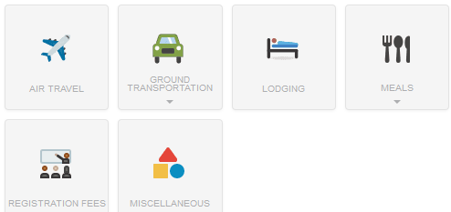
Tiles
Notes:
Accounts codes are imbedded behind each tile.

Slide 5
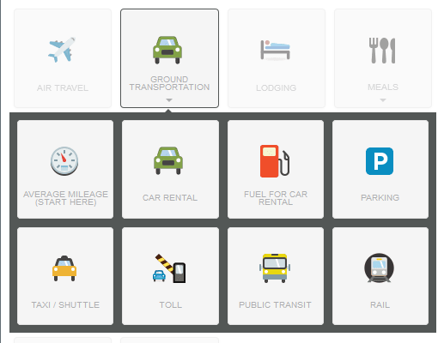
Drawers

Slide 6
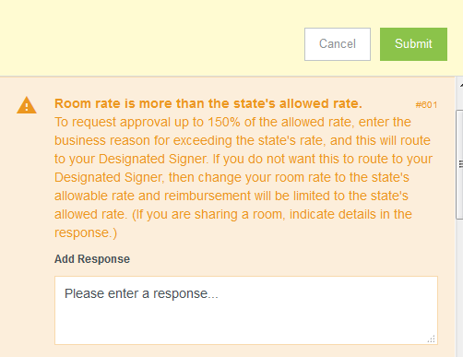
Applies Policy

Slide 7
Mobile, Tablet, Laptop
Notes:
No app needed.

Slide 8
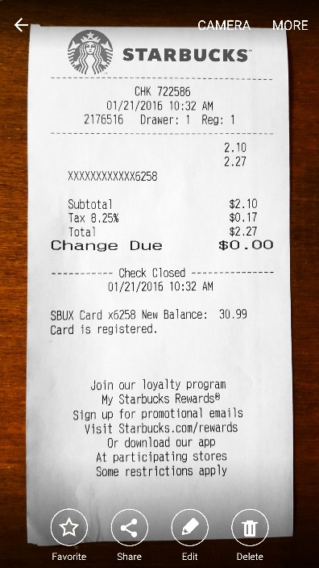
Snap and Send

