Slide 1

UMW SBITAs
Updated FY26

Slide 2
Arin Doerfler
Associate Controller
adoerfle@umw.edu
Eagle Village 480
x1230
Melinda Albrycht
Asst Director of Accounting
malbyrch@umw.edu
Lee Hall Room 239
x1227
Tania Ellis
Senior Accountant – Fixed Assets
tellis2@umw.edu
Lee Hall Room 241
x1244

Slide 3
SBITAs (Subscription-Based Information Technology Arrangements)

Slide 4
What is a SBITA?
It is an agreement where a government entity (UMW) gets the rights to use another company’s IT software for a specific period of time
The agreement allows UMW to use the software, either alone or with related equipment.
The use of the software is for a specific period of time, not a perpetual license.
UMW provides something of value ($$$) in exchange for the right to use the software
SBITAs are governed by GASB (Government Accounting Standards Board) 96
Why is it important?
It is important because the Government Accounting Standards Board requires it!

Slide 5
Examples of SBITAs:
Software Licenses
Bundled Software Licenses that include maintenance and support
Databases
Training Software
Cloud-based services
Software as a Service (SaaS)
Infrastructure as a Service (IaaS)
Platform as a Service (PaaS)

Slide 6
Account Codes
71222S Employee Subscriptions
71275 Software Maintenance
71277 Computer Services
71279 Software Development
72218 Software Under 2K
72226 Subscriptions (serial/periodical) Library
72227 Electronic Subscriptions Library
72229 Electronic Resources Library
71279L Software Dev Licenses (Limited Term) INACTIVE
72218L Software Licenses
72218S SBITA Software*

Slide 7
eVA Entry of SBITAs
Purchases using the account codes from the previous slide route to the eVA SBITA Approver(s)
The approver looks for the following information:
A complete description of what is being ordered
Dates of Service Period
Contract Number, if provided
IT Ticket Number
If the SBITA Approver can determine from the eVA order (and past orders) that the software being purchased is going to be classified as a SBITA, the approver will ask you to change the account code to 72218S.
If the SBITA Approver cannot determine from the eVA order that the software is going to be classified as a SBITA, the approver will send you a follow-up email with a list of questions ahead of issuing an eVA approval.

Slide 8
Is this a renewal or a new purchase?
Are there specific renewal options?
Do you intend to renew this again in the future?
What is the payment frequency?
What is the purpose of the software?
Does UMW create and grant user access?
Can UMW access the software at any time?
Can UMW make configuration changes or customize the software?
IF the buyer answers NO to the above three questions (#6-8), the software does NOT meet the criteria to be classified as a SBITA.
Start Date
End Date
Can UMW terminate without cause, without consent of vendor, with notice of 12 months or less?
Can the Vendor terminate without cause, without consent of UMW, with notice of 12 months or less?
IF the buyer answers YES to the above two questions (#11-12), the software does not meet the criteria to be classified as a SBITA.
Does the agreement automatically renew?

Slide 9
DebtBook Entry of SBITAs
UMW uses DebtBook to track SBITAs
The required information needed for DebtBook entry:
A fully-executed Purchase Order
Invoice
Contract (where applicable)
NEW for FY26 – purchases coded to 72218L, 72218S and the three Library Codes route to our Fixed Asset T-Tag report to signal that the buyer/end-user has received on the purchase and that the invoice has been sent to AP and processed for payment or that an SPCC transaction has been posted.
Melinda will reach out to you for invoices for PO purchases
For SPCC purchases, WORKS will be utilized to get a copy of the invoice.

Slide 10
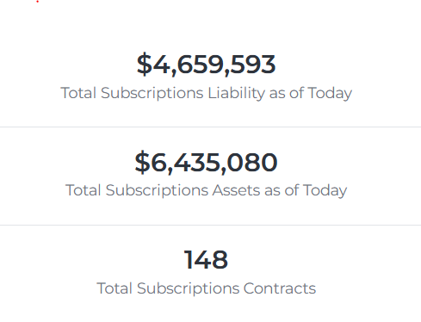
UMW Current Stats:
Sycom – Cisco
Ellucian – Chrome River
CDWG – Adobe
LeepFrog
PageUp
SHI – Microsoft
Handshake
Localist Event Calendar
ProQuest Databases
Instructure – Canvas
Capture – Behavioral Intelligence Platform

Slide 11
Need Help?
Reach out to Melinda or Arin with questions!
Information can be found on the UMW Accounting website.
https://adminfinance.umw.edu/accounting/sbitas/

