Slide 1

April 2026 BUG Meeting

Slide 2
Welcome – New SPCC Program Administrator
Noreen Bednar
Office: 540-654-2087
Email: nbednar@umw.edu
Please use spcc@umw.edu when submitting questions, concerns, or issues for the time being.

Slide 3
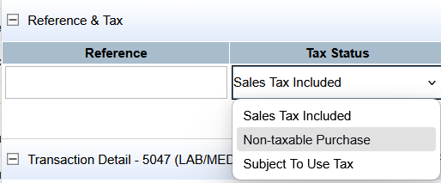
Taxes…Taxes…Taxes!
When allocating transactions in Works, PLEASE review your invoices for any sales tax applied. If you are NOT charged tax, change the Tax Status from Sales Tax Included to Non-taxable purchase.

Slide 4
Annual Training
The Annual SPCC Cardholder and Approver training was assigned to everyone on March 24. Training is performed through Canvas. If you have issues accessing the training, contact me ASAP!
DUE APRIL 24, 2026
  Guide on Accessing SPCC and Finance Fundamentals Training in Canvas

Slide 5
Refresher – KNOW Before You Go (Buy)!
It’s imperative that you KNOW the following information BEFORE making a purchase or issuing a payment:
  Your card limits and restrictions
  Your supplier (eVA registration, payment methods including any card fees, how they accept orders, etc.)
  Your FOAP! Your FOAP will partially tell you how you can pay
    Fund Type and Card Use report
  Your procurement requirements (competition & purchase order entry)

Slide 6
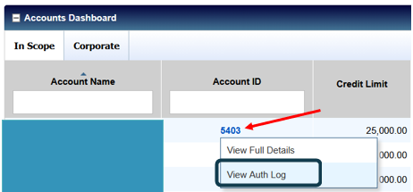
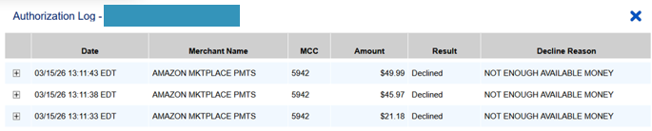
Card Declines
If your card is declining and you don’t know why, you can check it!
Why Is My Card Declining? (Guide and Explanation)

Slide 7
eVA Clean Up
As we approach the end of the Fiscal Year, apply some spring cleaning to eVA:
  Go through your drafts to make sure anything that needs to be submitted gets submitted before the end of the FY.
  Check for any requisition rejections.
  Close out blanket purchase orders and issue change orders to reflect amounts actually paid for that time period. For questions about the purchase order close out process, please contact TCSS (tcss@umw.edu)

Slide 8
SPCC Fiscal Year End Deadline
The LAST day for transactions to POST to BOA Works for those transactions to hit the FY26 budgets is end of day May 15, 2026.
Any transactions that post to Works beginning May 16 will automatically be on FY27 budgets. There are no exceptions!
If you have placed an order and have NOT seen it charge to Works yet, contact your vendor to figure out what happened.
***Please be aware that if payment wasn’t made but was expected (even if it’s the vendor’s fault) and it’s over the 30 day prompt pay window, you MUST get DOA approval before authorizing the vendor to charge the card.

Slide 9
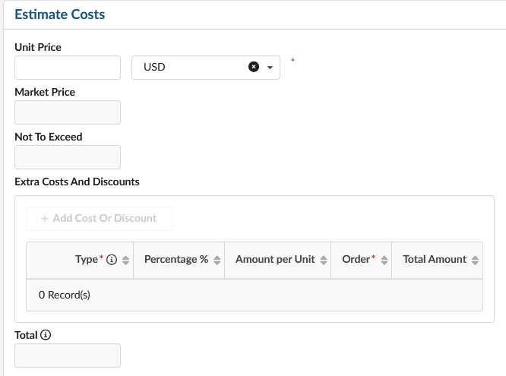
eVA Line Item Estimate Costs Section
Don’t Use!
Don’t Use!
Don’t Use!

Slide 10
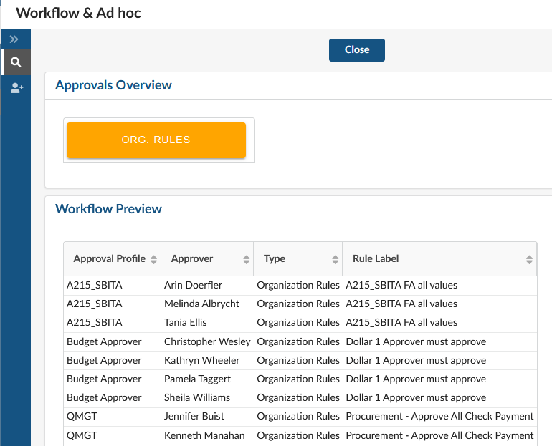
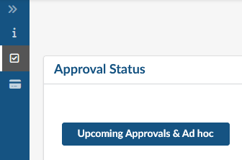
eVA Approval Workflow
Wondering where your purchase is within the approval workflow in eVA?

